Slide 1





SAMPLE SUPER STORE
An analytical approach by Rahul Kadere
Project File Link : https://colab.research.google.com/drive/15Y06wn3UsAqpTY-LnB8fM3ZaixWrb-Hh?usp=sharing
Dataset link : https://www.kaggle.com/datasets/bravehart101/sample-supermarket-dataset

Slide 2



Steps taken in the project
Data Collection
Gathered comprehensive data from transaction records of a superstore, including sales, profit, and customer demographics.
Data Preprocessing
Cleaned the dataset to remove missing or duplicate values, ensuring consistency and accuracy for analysis.
Data Analysis
Applied statistical and visualization techniques to identify sales trends, regional performance, and customer behavior patterns.
Model Building and Visualization
Built predictive models to forecast sales and profits and used visualizations like bar plots and pie charts for actionable insights

Slide 3


Questions
Q 1: What is the total profit generated?
Q 2: Which product category contributed the most to total sales?
Q 3: What is the average discount offered across all orders?
Q 4: Which ship mode is the most commonly used?

Slide 4




Introduction
The Superstore Sales Analysis project aims to explore and understand the key factors influencing sales performance and profitability in a retail environment. By leveraging data-driven insights, this project seeks to identify trends, optimize business operations, and improve decision-making processes. The analysis covers various aspects, including customer behavior, regional sales distribution, and product performance, providing a comprehensive view of business dynamics.

Slide 5


Project objective
The primary objectives of the Superstore Sales Analysis project are:
To analyze sales performance and profitability across different regions and product categories.
To identify key factors driving customer purchases and revenue growth.
To uncover patterns in customer behavior to inform marketing and sales strategies.
To highlight areas for operational improvement and cost management.
To provide actionable insights for data-driven business decision-making.

Slide 6




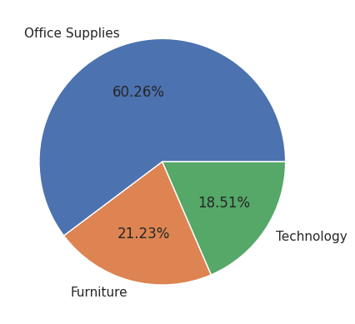
Category-wise Sales Distribution
The pie chart reveals the distribution of sales across three categories: Office Supplies, Furniture, and Technology.
Office Supplies dominates the sales, accounting for a substantial 60.26% share.
Furniture follows with a 21.23% share of sales.
Technology contributes the least to sales, with a share of 18.51%.
Overall, the chart highlights a significant disparity in sales across the categories, with Office Supplies clearly leading in terms of revenue generation.

Slide 7
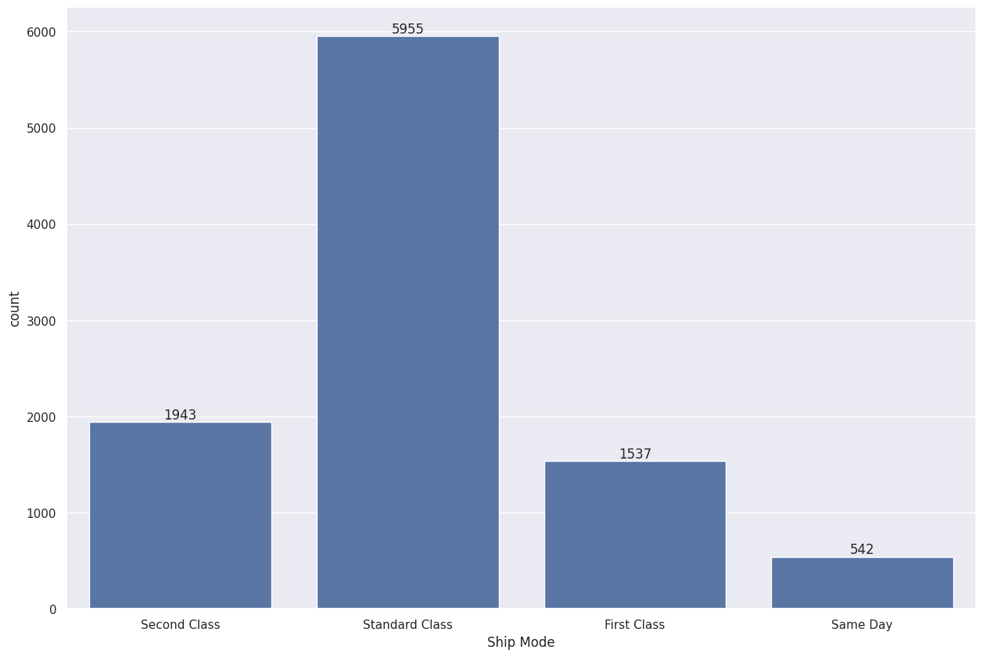
Shipping Mode Distribution with Count Labels
The bar chart illustrates the distribution of shipping modes, revealing the frequency of each mode used.
Standard Class is the most preferred shipping mode, with a count of 5955.
Second Class comes in second with 1943 shipments.
First Class is used for 1537 shipments.
Same Day shipping is the least frequent, with only 542 shipments.
Overall, the chart highlights a strong preference for Standard Class shipping, indicating that it might be the most cost-effective or suitable option for the majority of orders.

Slide 8
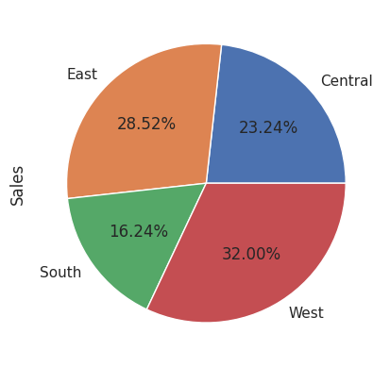
Sales Distribution by Region
The pie chart illustrates the distribution of sales across four regions: East, Central, South, and West.
The West region leads in sales, capturing a substantial 32.00% share.
The East region follows with a 28.52% share of total sales.
Central and South regions contribute 23.24% and 16.24% to the total sales, respectively.
Overall, the chart highlights a significant disparity in sales across the regions, with West and East being the top performers.

Slide 9
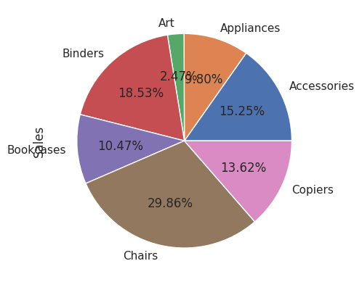
Top 7 Sub-Categories by Total Sales
The pie chart illustrates the distribution of total sales across the top 7 sub-categories.
Chairs hold the largest share of sales, accounting for a substantial 29.86%.
Binders follow with a 18.53% share of total sales.
Accessories and Copiers contribute 15.25% and 13.62% to the total sales, respectively.
The remaining sub-categories (Bookcases, Appliances, Art) have smaller shares, ranging from 2.47% to 10.47% of the total sales.
Overall, the chart highlights a significant disparity in sales across the sub-categories, with Chairs and Binders being the top performers.

Slide 10



Summary and findings
Sales and Profit Distribution
The highest sales were observed in the technology category, while the furniture category had lower profit margins despite significant sales volume.
Regional Performance
The Western region showed the highest profitability, whereas the Southern region had lower overall performance due to higher discounts.
Customer Segment Analysis
The corporate customer segment contributed significantly to profits, while the home office segment had lower transaction values.
Shipping Mode Impact
Standard-class shipping was the most commonly used but had lower profit margins compared to expedited shipping.
Discounts vs. Profitability
A negative correlation was found between higher discount levels and profit margins, indicating the need to optimize discount strategies.

Slide 11


Conclusion
The Superstore Sales Analysis project provides valuable insights into the performance and profitability of different product categories, customer segments, and regions. The key findings highlight the importance of optimizing discount strategies and focusing on high-margin products to boost profitability. Improved shipping and operational efficiency can further enhance business outcomes. Future recommendations include leveraging advanced predictive models to forecast sales trends and using targeted marketing strategies to drive customer engagement and growth.

Slide 12


Thank You!

